Slide 1
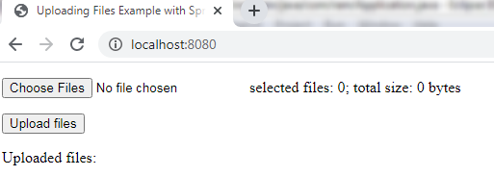
Spring Boot File Upload Example with MultipartFile
Will See how to upload multiple files in Spring Boot with MultipartFile

